Slide 1
Layout Global Variables and Static Variables
PrintNet T

Slide 2
Agenda
Layout Global Variables
Layout Global Variables Methods
Pre-processing
Layout Global Variables Optimization
Static Variables

Slide 3

Layout Global Variables

Slide 4

Global Variables Purpose
Values cumulation
Remembering of a variable value through layout
Can be applied on the complete document, not just a single page
Their values can be modified:
  Within one layout page
  Through a whole job
Can be contained in charts, tables, sheet names, etc.
Practical example is listing all pages of a PDF file

Slide 5


Global Variables – Example
Stocks statement of several clients contains their information, stocks information and
cumulative price of stocks. This cumulative value is calculated for each client.
Open Example Table Client.wfd
This is a statement of clients of FIIIF Stock Exchange
Each client has his/her
  Personal information displayed
  Stocks listed
The last column contains a cumulative price of stocks
When a client has several repeated pages, this cumulative value is transmitted correctly between the following pages
This cumulative price is a global variable and starts from zero for each client
Notes:
There is a possibility to modify this example so that:
Stocks statement of several clients contains their information, stocks information and
cumulative price of stocks. This cumulative value is calculated for all clients together.
Steps to take:
Open Example Table Clients.wfd
This is a statement of clients of FIIIF Stock Exchange
Each client has his/her: a) personal information displayed, b) stocks listed
The last column contains a cumulative price of stocks
When a client has several repeated pages, this cumulative value is transmitted correctly between the following pages
This cumulative price is a global variable and is calculated for all clients together

Slide 6

2. Layout Global Variables Methods

Slide 7
Global Variables Methods Overview
Using Auto add for calculating global variable
Writing to Global variable from a variable placed in a Flow
Writing to Global variable from a variable placed on Next Page

Slide 8


Global Variables Methods Schema
Auto Add
Write To Global
X
Y
Z
X
Y + X
Z + Y + X
A
X
Y
Z
X + A
Y + X + A
Z + Y + X + A
Notes:
Global variable value is the second column of each section. For Auto Add, the value of global variable is X, Y+X, Z+Y+X
Note: A is a variable which is additionally added to the global variable, but perhaps just once

Slide 9
Global Variables Methods Schema
Write To Global using a variable in the Next page tab
Page 1
Page 2
X
Write To Global
X + Y
Y
Notes:
X + Y is the value of a global variable

Slide 10
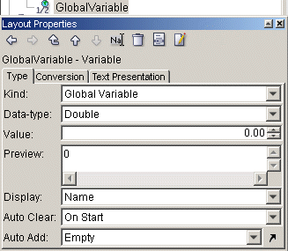
Auto Add and Auto Clear
  Auto Clear – resetting the
  value of global variable
  Auto Add – updating the
  Value of global variable
  Auto Clear – resetting the
  value of global variable
  Auto Add – updating the
  Value of global variable
  Auto Clear – resetting the
  value of global variable
  Auto Add – updating the
  Value of global variable

Slide 11


Auto Clear Schema
Page 1
Page 2
Page 3
X X
Y Y+X
Z Z+Y+X
A A
B B+A
C C+B+A
D D
E E+D
F F+E+D
Global variable resetted
Notes:
Global Variable is in the red frame
In this example the global variable is resetted each page

Slide 12
Auto Add
Purpose: Serves for simple cumulation of a variable (Integer,
Double, etc.)
Necessary steps:
Need to use variable (placed somewhere on the page) which should be cumulated in global variable
Flowing to next page must be checked on the flow where the variable (which updates the global variable) is used.
Global variable should be cleared. (See option Auto clear)
Make sure that the order of processed objects is correct
Notes:
Order of processed objects means:
There are two variables: a variable which should be added into the global variable and a global variable (cumulative)
If the variable is processed before the global variable, i.e. it is in front of the global variable in the Layout tree AND the global variable should cumulate the values of the variable, the whole process works correctly.
If the global variable is placed in front of the variable in the Layout tree, it is processed before this variable, therefore when displayed for the first time, it returns zero. When displayed for the second time it displays the value of the variable from the first display.
Flowing to next page needs to be checked on the flow area only when we need the values to overflow and therefore be remembered for further pages.

Slide 13
Auto Clear
Possibilities to reset variable:
On Start
Each Record
Each Page Repetition
Each Page
Note: There is no “Auto Initialize” option, so global variable cannot start from a fixed customized value.
Notes:
On Start – only at the beginning of the job, never gets cleared from now on
Each Record – at the beginning of each record (Data | Records By)
Each Page Repetition – at the beginning of a new page sequence (Pages | Repeated By)
Each Page – at the beginning of each page

Slide 14
Auto Add – Example
Numbers are generated and their sum is calculated. There are two sums on each page –
sum from previous page and sum ending on the actual page.
Example file: Auto Add Example.wfd
Two flow areas on each page
First flow area contains the total cumulative value from the previous page
Second flow area contains the total cumulative value at the end of the present page
Therefore there are two flow areas using the same global variable
It is necessary to specify which flow area is processed first
Auto Clear option can be set to anything but Each Page
Notes:
The reason why it is possible to set Auto Clear to anything except for Each Page is that there are no records (Data | Records by empty), no repeated pages (Pages | Repeated by Empty)

Slide 15
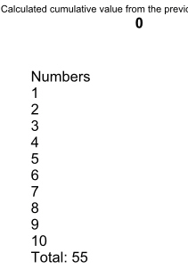
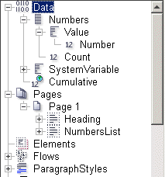
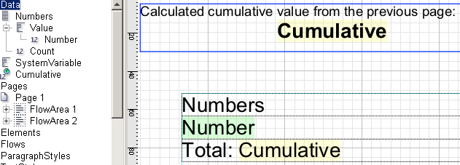
Auto Add – Example
Flow Area 1 is processed first (in Layout Tree, it is located in front of Flow Area 2)
Flow Area 2 is processed the second
Proof
Layout
Notes:
The value of cumulative global variable in the first flow area shows the value before anything else is processed on the page (it remembers the value from the previous page). This screenshot shows the first page, therefore the global variable in the upper flow area equals to 0, because global variable has not been updated yet.
The value of global variable in the second Flow Area contains the value after everything has been processed on the page, so the global variable is fully updated. The same value will appear on the next page in the first flow area.

Slide 16
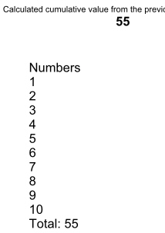
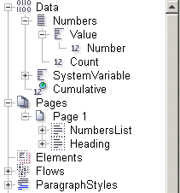
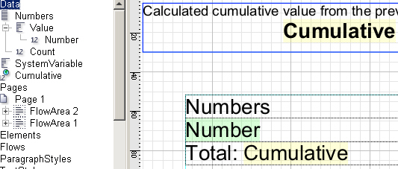
Auto Add – Example
Flow Area 2 is processed the first (in Layout Tree, it is located in front of Flow Area 1)
Flow Area 1 is processed the second
Proof
Layout
Notes:
The value of cumulative global variable in the first flow area shows the value after everything else is processed on the page (it remembers the value from the actual page)
The value of global variable in the second Flow Area contains the value after everything has been processed on the page, so the global variable is fully updated. The same value will NOT appear on the next page in the first flow area, because this flow area is processed the last.

Slide 17
Auto Add – Exercise
Design a bank statement showing all client’s transactions and calculating their
cumulative value.
Open Auto Add Exercise.wfd
Look at Auto Add Exercise Done.pdf to see the result
Fill the table with variables and do not forget to add a global variable
This variable calculates the cumulative transactions value
Do not forget to display the final delta and the paging
Check your result at Auto Add Exercise Done.wfd

Slide 18
Writing to Global Variable
Purpose: Updating a global variable using scripted (complex)
conditions
Another way to update a global variable is to have a variable which updates this global variable
The position of updating variable must be considered (processed after or prior to global updated variable)
Flowing to next page option must be checked on the flow area where the updating variable is
Notes:
Another way to update a global variable is to have a variable which updates this global variable by its script as a side effect.
Again, setting Flowing to next page option should be checked for Flow Area only when its values are expected to overflow, otherwise there is no need to check this option.
The updating variable has a script inside which updates the global variable (as a side effect of this variable, global variable is updated). Since we use this writing variable somewhere on the page and do not need to display anything in its position, this variable will return just empty string, i.e.: return “”;

Slide 19
Writing to Global Variable – Example
A bank statement calculates the client’s balance and it is taking into account his / her
starting balance.
Open WriteToGlobal Example.wfd
Global variable is auto cleared each record
There is a new variable WritingIntoGlobal which updates the global variable:
  If there is the first transaction it will display sum of initial balance and the first transaction
  If there are other transactions it will increment the global variable with the current transaction value
The WritingIntoGlobal variable must be used somewhere on the page in order to update the global variable
Notes:
Again, it matters where the WritingToGlobal variable will be (after or prior to global variable)
The following examples will show both options when updating and global variable are processed in different order

Slide 20
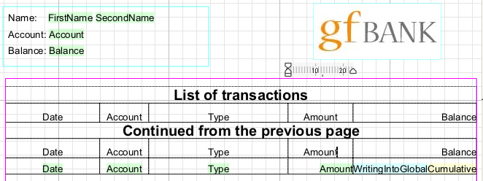
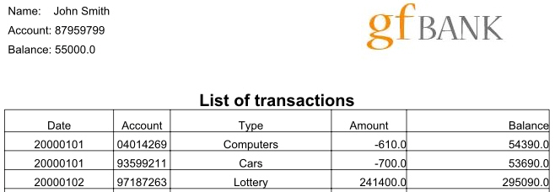
Writing to Global Variable – Correct Example
Layout
Proof
Notes:
The WritingIntoGlobal variable is placed in front of Global variable and therefore updates it by its script. The table works properly and since it also has Flowing To Next page checked all information is flowing to following page till the end of statement.

Slide 21
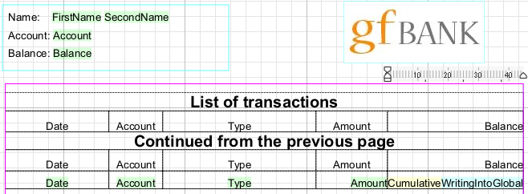
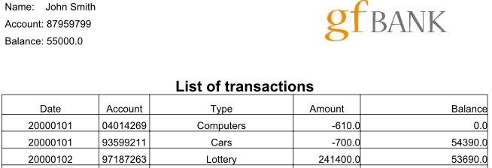
Writing to Global Variable – Wrong Example
Layout
Proof
Notes:
WritingToGlobal Variable is placed after global variable. That is why the global variable is evaluated the first and its value is zero because no variable has updated it. The first row of the table contains 0 on the place of global variable. The second row contains the balance plus the previous transaction. Global variable updated value is “lagging” by one row.

Slide 22
Writing to Global Variable – Exercise
Design a list of IT department items along with their prices. The last column of the table
contains a cumulative value of items prices.
Open WriteToGlobal Exercise.wfd
Look at WriteToGlobal Exercise Done.pdf to see how the result should look like
Fill the table with corresponding data
The last column, Cumulative Price, should contain a global variable representing cumulative price of the items
Global variable must be updated by a scripted variable
Result is WriteToGlobal Exercise Done.wfd
Notes:
Note: this exercise can be done also using auto add feature of global variable. Try both of the solutions.

Slide 23
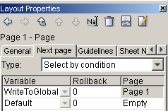
Updating Global Variable Via Next Page
Possible to have a variable which writes into global variable in Next page conditions
A script inside
Can be, e.g. of a boolean type
Notes:
unknown content of the global variable until the first page is processed.
very useful for remembering values from page to page
A script inside variable updates a global variable
Since it is boolean variable it e.g. returns false value, so that the condition is never executed, but the variable is processed

Slide 24
Updating Global Variable – Example
A statement of all ordered IT department items contains their details and their cumulative price. This price is a global variable calculated via a variable in Next page tab.
Open WriteToGlobal Next Page Example.wfd
There are two “special” variables:
  WriteToGlobal – updates the global variable
  Cumulative – returns cumulative items price
WriteToGlobal variable is placed Next Page tab as one of the conditions
Every time this condition is evaluated, the global variable is updated (updated value is shown on the next page)

Slide 25
Updating Global Variable – Exercise
Design a list of client’s credit cards account and balances. Calculate a cumulative sum
of balances. Use the Next Page tab.
Open WriteToGlobal Next Page Exercise.wfd
Look at WriteToGlobal Next Page Exercise Done.pdf to see how the result should look like
Design the similar solution:
  Calculate a cumulative sum of all balances – global variable
  Use a boolean variable which will update the global variable
  Place it into the Next Page tab
Result is WriteToGlobal Next Page Exercise Done.wfd

Slide 26

3. Pre-processing

Slide 27
Pre-processing
Needed in order to obtain:
  The real sequence of pages
  Total number of pages
  Evaluation of global variables
Due to:
  Variable page selection
  Text flowing
  White space management
  Run arounds

Slide 28
Pre-processing
If there are conditions from previous slide, pre-processing is needed
Steps during processing:
  Modules to process analysis
  Data Tracing needed?
    Yes – pre-process data
  Layout pre-processing needed?
    Yes – Layout pre-processing
  Error Recovery?
    Yes – Error Recovery pre-processing
  Complex Impositioning modules?
    Yes – Impositioning pre-processing
  Process
  Post-process
Variable which updates global variable must be placed in a flow area which is overflowing
Notes:
If there are conditions from previous slide, then pre-processing is needed since it is not possible to get all the necessary values in single processing only
Analyze Modules to Process
The workflow is processed "from right side to the left" to optimize the pre-processing- the output module calls its connected module, the imposition modules and then calls preprocess to all its inputs. Only the modules relevant for current output are processed.
Data Tracing Phase
Data input modules are “traced” and indexes of individual entries are stored as temporary results
Simple data processing modules just trace the data through. Data processing modules used for changing record structure (e.g. Data Sorter) temporarily store their results. This data tracing does not occur when the data are already accessible in the PrintNet T internal data format; this is case of Data Cacher and Internal Data Input.
Layout pre-processing Phase
Layout pre-processing is necessary when any of following conditions is met:
In Pages node, there is set Variable page selection or Data page selection
Layout contains global variables that are not reset on each page (numbering variables are considered as global variables)
Any page contains Flow Area flowing from page to page, Message Area or variable Sheet Name
Layout is set to Error Recovery
pre-processing in Layout Module
For each record (record is determined by setting the value of Data Repeated By):
The pre-processing starts on Start page. The next pages are processed according to Next pages conditions.
The sequence is repeated if Pages Repeated By value is specified.
Then White space management added pages, then all sheet names from each individual page are evaluated, but in context before processing of the appropriate page. Any changes of global variables made in the context of currently processed page are abandoned.
pre-processing of Individual Pages
Values of global variables and flows that flow from page to page are stored.
Error Recovery pre-processing
After normal pre-processing in Layout there optionally can be error recovery pre-processing. All pages in layout are evaluated in nearly identical way as in drawing (output) stage;

Slide 29

4. Layout Global Variables Optimization

Slide 30
Updating Global Variables by Variables in Tables
Global variable updated by variables stored in tables
Variables which update global variables are placed in a table with:
Custom cell height
Fixed cell height
Fixed cell height with option Always Process set to Yes for cells containing updating values.

Slide 31
Updating Global Variables by Variables in Tables
Comparison:
See Testing.wfd and proof each Layout to check the processing time
Custom Height | Fixed Height | Fixed Height with Always Process option
Slowest processing | Fastest processing | Faster processing
Global variables work correctly | Global variables do not work correctly | Global variables work correctly
Notes:
The reason why global variables do not work correctly for the middle case example is:
During preprocessing, cell is not formatted, therefore does not influence global variables.

Slide 32
Tables Example
A statement contains cumulative prices of office equipment. Study the differences
among the three displayed tables.
There are three tables listing the cumulative prices of office items:
Table with custom height
Table with fixed height
Table with fixed height having the cell which contains the writing variable set to always process.
Study the differences of tables
Notes:
The reason why two tables are longer than the first one is because they have some fixed height of the cells.
These tables can have either a variable which updates the global variable OR a global variable with auto add option. In any of those cases the cell which contains this updating variable must be set to always process.

Slide 33

5. Static Variables

Slide 34
Overview
Declaring a variable with the keyword static:
Keeps the variable valid and accessible
Used for sharing data among all scripts in the workflow.
Possible steps:
  Define a variable in script data input
  Use and modify in layout
  Use and modify in impositioning script module
Notes:
Note: This is not obligatory sequence of steps. Static variable can be created in layout and used in e.g. impositioning script module, or can be just defined in impositioning script itself. Generally static variable definition or use can take place anywhere script is written.
Keeps the variable valid and accessible from all scripts during the whole run of a workflow

Slide 35
Example
We define a static connection to a database in Script Data Input module, use it and then
later on, call this static variable storing this connection for a different purpose.
Static variable can be any variable type (Int, Double, etc.)
Can store an ODBC connection
They are more than just global variables, they are workflow global variables
The script can look like:
      static Bool dbConnected;
      static ODBC.Database db;
      if(not dbConnected)
      {
      db.connect("DSN=Excel Files;DBQ=C:…..");
      dbConnected=true;
      }

Slide 36
Global vs. Static Variables
Comparison:
Global Variables | Static Variables
Located only in Layout | Located anywhere in workflow where scripting is available
Rollback or overflow available | Rollback or overflow not available
Auto add, auto clear possibility | Controlled only by the designer
Notes:
Note: A designer is fully responsible for his/her static variable, so it can be updated only by designer’s action
Global can have auto add, auto clear, etc.

Slide 37

Global Variables – Summary
In this presentation we learned about:
Basics of pre-processing
Various types of
  Use and updating of global variables
  Clearing global variables
Order of processed objects

Slide 38


Global Variables – Discussion
Can you answer the following questions?
What is a global variable?
What methods of updating and clearing global variables do you know?
Does it matter when global variable is processed prior to its updating variable?
What are the three possibilities of placing global variables into a table and what are their advantages and disadvantages.
Notes:
Global variable is a variable which is remembered from page to page, or within the entire job
Updating – auto add or some another variable which updates this global variable. Clearing – on start, each record, each page, each page repetition
Yes, because first the global variable is shown and then a variable which should update this global variable is processed. It is too late, because the global variable has been shown already.
Table with custom height of cells – slow, but global variables work correctly (their values are passed and updated from row to row)
Table with fixed height – fast, but global variables passing does not work correctly
Table with fixed height with always process option set upon the cell which contains either the updating variable or the variable which is auto-added in a global variable.

Slide 39
Thank You.
Do You Have Any Questions?

